Slide 1

IOT and System Platform From Concepts to Code
Andy Robinson
Avid Solutions

Slide 2
Introductions

Slide 3



Introductions
Andy Robinson​
Information Solutions Consultant with Avid Solutions in Raleigh
2 years as Principal at Phase 2 Automation​ in Taiwan
10 years with Avid Solutions
5 years with Monsanto/Solutia in Decatur, AL and Houston, TX​
​Co-Founder of aaOpenSource
The Archestranaut​

Slide 4
Overview

Slide 5
Overview/One-Eyed People
I am NOT an expert
In the land of the blind
…the one eyed man is king

Slide 6
Overview/My Definition of IOT
What would/could you do differently if the cost of the hardware and comms for your system approached $0?
Sensor
Transmitter
I/O Channel
Gateway
Data Server
Visualization
Alarming
Complex Machine
Storage
Notes:
Not going to try to one up what’s been said by many people smarter than me have defined IOT in terms of the technology and the promise for hundreds of trillions of dollars in savings. Instead when I think of IOT I think about a mindset. That mindset being “what would you…”

Slide 7
Overview/Parts and Pieces
Many Moving Pieces
Visualization
Analytics
Clients
Data Transmission
Servers
Notifications
Storage
Notes:
So when you dive a little deeper you find a lot of moving parts when it comes to tx/rx of IOT data. In this talk I’m going to focus almost exclusively on the data transmission and receipt part. So… let’s get started because I’ve got about 50 slides to get through.. With demos…

Slide 8
Overview/Data Transmission
Two Core Pieces
Transport
TCP – connection oriented, packets are confirmed and retransmitted if failed
UDP - connectionless , fire and forget
Protocol
HTTP
XMPP
CoAP
AMQP
MQTT
Notes:
Any time you send/receive data over a network you have to consider both the transport and the protocol. For transport you’ve got two primary options, TCP and UDP. The simplistic difference between the two is that TCP confirms receipt of a packet, allowing for retransmission if it doesn’t make it while UDP does not. This makes UDP a lot lighter weight and easier to wake up and send data but you have to deal with a lot of issues yourself. The next part is the protocol. And that’s what I’m about to spend a lot of time talking about. The protocol is how the two ends of the conversation know how to interpret the packets flying back and forth.

Slide 9

Overview/Data Transmission/HTTP
Same core protocol as web page delivery
Uses a RESTful pattern with HTTP verbs (GET/POST) and specific URL’s
Client-Server with Request/Response
Notes:
So first up, HTTP. This is your old school method for delivering web pages but with a new twist, a RESTFUL pattern. Without getting too far into it, RESTful patterns are a way you can use existing HTTP verbs like GET/POST, etc. and specially formulated URL’s to get data and send data to the server. But fundamentally this is a request/response pattern where every time you want data it’s a new independent transaction as well as sending data.

Slide 10
Overview/Data Transmission/HTTP
Benefits
Easy path through firewalls (HTTP/80, HTTPS/443)
Out of the box transport security with SSL/TLS
Very well known so easy to get started

Slide 11
Overview/Data Transmission/HTTP
Drawbacks
Huge overhead from headers 700-800 bytes¹ (should be better with HTTP/2)
RESTful patterns are inherently slow and require polling
(1) http://dev.chromium.org/spdy/spdy-whitepaper

Slide 12

Overview/Data Transmission/XMPP
eXtensible Messaging and Presence Protocol
XML over TCP
Originally started as a chat protocol to support contact lists and presence
Ask Eliot Landrum from Stone Technologies anything
https://en.wikipedia.org/wiki/XMPP

Slide 13
Overview/Data Transmission/XMPP
Benefits
Open standard
Flexible
Very mature (originated in 1999)
https://en.wikipedia.org/wiki/XMPP

Slide 14
Overview/Data Transmission/XMPP
Drawbacks
No QOS inherent at the protocol layer
Higher network overhead due to XML being text based
https://en.wikipedia.org/wiki/XMPP

Slide 15
Overview/Data Transmission/CoAP
Constrained Object Access Protocol
UDP but similar to HTTP with RESTful functions (GET/PUT/POST/DELETE)
Asynchronous communications model
Client-Server
http://www.slideshare.net/rickgaribay/from-the-internet-of-things-to-intelligent-systems-a-developers-primer-garibay-final-34875117
http://www.realtimecommunicationsworld.com/topics/realtimecommunicationsworld/articles/408622-pros-cons-the-major-iot-communications-protocols.htm

Slide 16
Overview/Data Transmission/CoAP
Benefits
Ultra small header (4 bytes) leads to ultra small packet sizes
DTLS for security
Combined with LWM2M for robust device management
Discovery methods built into protocol
Great for ultra low power, ultra low bandwidth
Datagram packet model can work over non IP transports like SMS
IETF Standard
http://www.slideshare.net/rickgaribay/from-the-internet-of-things-to-intelligent-systems-a-developers-primer-garibay-final-34875117
http://www.realtimecommunicationsworld.com/topics/realtimecommunicationsworld/articles/408622-pros-cons-the-major-iot-communications-protocols.htm

Slide 17
Overview/Data Transmission/CoAP
Drawbacks
Core protocol is client-server with server initiated communications → requires inbound packets to client device → security concerns
As single client to single server there is no built-in concept of data broadcast
http://www.slideshare.net/rickgaribay/from-the-internet-of-things-to-intelligent-systems-a-developers-primer-garibay-final-34875117
http://www.realtimecommunicationsworld.com/topics/realtimecommunicationsworld/articles/408622-pros-cons-the-major-iot-communications-protocols.htm

Slide 18

Overview/Data Transmission/AMQP
Advanced Message Queue Protocol
Originally developed by big financial orgs for middleware messaging
Message oriented binary protocol typically over TCP
OASIS Standard
https://en.wikipedia.org/wiki/Advanced_Message_Queuing_Protocol

Slide 19
Overview/Data Transmission/AMQP
Benefits
Built for resiliency and scaling
Load balancing patterns
Messages can contain payload and metadata
Powerful routing patterns
Transport security based on SSL/TLS

Slide 20
Overview/Data Transmission/AMQP
Drawbacks
Not lightweight – built with servers and fat networks in mind (60 byte minimum packet size)
Can be complex to implement client – thanks Paolo for SBLite

Slide 21

Overview/Data Transmission/MQTT
Message Queue Telemetry Transport
Created by IBM and others to support oil pipeline telemetry data over slow, unreliable networks
TCP Transport
Publish-Subscribe with Broker Model
http://www.slideshare.net/rickgaribay/from-the-internet-of-things-to-intelligent-systems-a-developers-primer-garibay-final-34875117
http://www.realtimecommunicationsworld.com/topics/realtimecommunicationsworld/articles/408622-pros-cons-the-major-iot-communications-protocols.htm

Slide 22
Overview/Data Transmission/MQTT
Benefits
Very small header (7 bytes) leads to very small packet sizes
TLS for transport security
Great for low power, low bandwidth
No incoming connection to client → much more secure
3 levels of QOS
OASIS Standard
http://www.slideshare.net/rickgaribay/from-the-internet-of-things-to-intelligent-systems-a-developers-primer-garibay-final-34875117
http://www.realtimecommunicationsworld.com/topics/realtimecommunicationsworld/articles/408622-pros-cons-the-major-iot-communications-protocols.htm

Slide 23
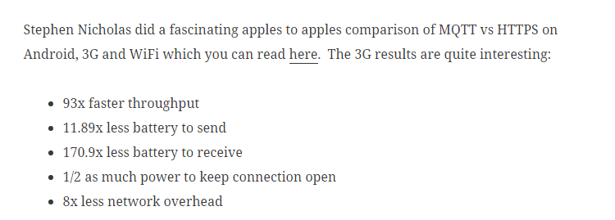
Overview/Data Transmission/MQTT
Benefits - Small size and low overhead
https://mobilebit.wordpress.com/2013/05/03/rest-is-for-sleeping-mqtt-is-for-mobile/

Slide 24
Overview/Data Transmission/MQTT
Drawbacks
TCP is connection oriented so more complex to put device to sleep (MQTT-S supports UDP)
No standard model for metadata and discoverability
No standard method for device management
http://www.slideshare.net/rickgaribay/from-the-internet-of-things-to-intelligent-systems-a-developers-primer-garibay-final-34875117
http://www.realtimecommunicationsworld.com/topics/realtimecommunicationsworld/articles/408622-pros-cons-the-major-iot-communications-protocols.htm

Slide 25
Overview/Data Transmission/Winner
And the best protocol is…the one that matches your requirements and capabilities
One of many comparisons
www.slideshare.net/paolopat/mqtt-iot-protocols-comparison
Would also love to talk about DDS (ultra high performance, data-centric)
….. but let’s talk about MQTT

Slide 26
MQTT – The Details

Slide 27
MQTT/Details/Transport
Utilizes single, duplex, persistent TCP connection for transport
Client connects to broker and broker sends data back down the connection
Broker NEVER connects directly to client. Security Win!
Client can use SSL/TLS to connect to Broker. Security Win!
Many brokers support authentication and ACL. Security Win!
Client
Broker (Server)

Slide 28
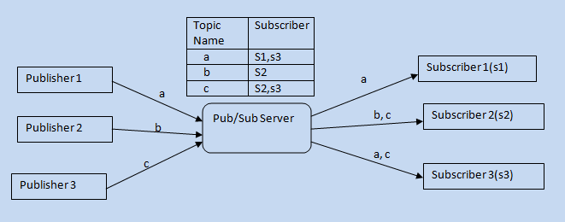
MQTT/Details/Communication Model
Pub/Sub with Central Broker
Conceptually similar to Mxaccess in System Platform
http://www.codeproject.com/KB/IP/PubSubUsingWCF/pubsub.png
Notes:
What does pub/sub with central broker mean? What it means is you start with a central collection point called a broker. The clients that have data publish data to the broker.. Using a topic to essentially name the data point. More about topics in a minute. Then for the clients that want data they connect to same broker and subscribe to a topic or multiple topics. So when a publisher sends out an update for topic A all of the clients that are subscribed to Topic A will automatically get the updated value.

Slide 29
MQTT/Details/Broker
Broker is meeting point for publishers and subscribers
Many different brokers available
Run locally or in the cloud

Slide 30
MQTT/Details/Broker
Local
mosquitto – The old man of the brokers, full featured, easy, single exe
GnatMQ – written in C#, open source
HiveMQ – extra features, commercial, extensible
Mosca – node.js, open source
Verne.MQ – written in Erlang, scalable and resilient, open source

Slide 31
MQTT/Details/Broker
Cloud
CloudMQTT – uses mosquitto
Public testers – test.mosquito.org, broker.mqtt-dashboard.com, …
Run your own on Azure

Slide 32
MQTT/Details/Topics
Mailboxes organized into folders
“/” separates the folders
Wildcards
Single Level → “+”
home/+/temp
home/1/temp
home/2/temp
Multi-Level → “#”
home/#
home/1/temp
home/2/temp
home/1/rh
home/2/rh

Slide 33
MQTT/Details/Topics vs Queues
Feature | Topics | Queues
Big Idea | Real Time | Asynchronous FIFO/Stack
Dropped Data | Can Be OK (but QOS) | Never Ok
Pub/Sub | Yes | Partial (only one client)
Applications | Sensor Data Alarms | Alarms Events Value History
Publish
Broker
Topics
Queue
Subscribe
HMI
HMI
“Client”
Value
Alarms
Events
HMI
HMI
Timestamped Values
Historical Values,
Alarms, Events
Alarms
Events

Slide 34
MQTT – The Code

Slide 35
MQTT/Code/Client Library
You only need a client library to pub and sub .. unless you want to run a broker too
Client libraries for almost every language
Best C# library is M2MQTT from Paolo Patierno
Open Source
Full Featured
Nuget Package Available

Slide 36
MQTT/Code/Pseudocode
Create Client
Set Options (ClientID, SSL/TLS?, QOS, Credentials)
Connect to Single Broker by Name or IP Address
…..
Subscribe to Topic(s) → Receive Callback for Subscribed Topic → Decode UTF-8 encoded binary data received
….
Publish UTF-8 encoded binary data to Topic(s)

Slide 37
MQTT/Code/System Platform/Publish
… Declarations….
configHost = "localhost";
configclientID = Me.Tagname;
MQTTClient = new uPLibrary.Networking.M2Mqtt.MqttClient(configHost);
MQTTClient.Connect(configclientID);
if (MQTTClient.IsConnected) then
Topic = "data/" + Me.Tagname + "/value";
MQTTClient.Publish(Topic,System.Text.Encoding.UTF8.GetBytes(Me.Value));
endif;

Slide 38
MQTT/Code/System Platform/Subscribe
Not possible due to requirement for callback registration
But you can use the AOT – been there done that.. mostly
_mqttClient.MqttMsgPublishReceived += _mqttClient_MqttMsgPublishReceived;
_mqttclient.subscribe(Topic)
…
void _mqttClient_MqttMsgPublishReceived(object sender, MqttMsgPublishEventArgs e)
{
Process new message e
}

Slide 39
MQTT – The Demos

Slide 40
MQTT/Demo
Demo 1 – Publishing simple data from System Platform

Slide 41
MQTT/Demo
Demo 2 – Publishing complex data from System Platform

Slide 42
MQTT/Demo
Demo 3 – Subscribing to Data “in” System Platform

Slide 43
MQTT/Demo
Demo 4 – MQTT → Wonderware Historian (no System Platform)

Slide 44
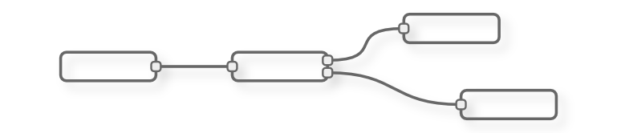
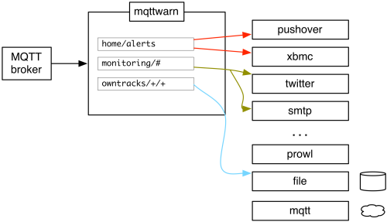
MQTT/Demo
Demo 5 – MQTT → Node-Red → ??
MQTTWarn
amqp
apns
asterisk
carbon
dbus
dnsupdate
emoncms
file
freeswitch
gss
http
instapush
irccat
linuxnotify
log
mqtt
mqttpub
mysql
mysql_dynamic
mythtv
nma
nntp
nsca
osxnotify
osxsay
pastebinpub
pipe
prowl
pushalot
pushbullet
pushover
redispub
rrdtool
slack
sqlite
smtp
syslog
twilio
twitter
xbmc
xmpp
xively
zabbix

Slide 45
MQTT – Resources

Slide 46



MQTT/Resources
MQTT.org
Paolo! - m2mqtt.wordpress.com/
Eclipse paho- www.eclipse.org/paho/
AMQP on Microsoft Azure - github.com/ppatierno/azuresblite
Talk to Alvaro Martinez about the new OI Server for MQTT!
aaOpenSource Github Repo github.com/aaOpenSource/aaMQTT

Slide 47
Wrap-Up

Slide 48
Wrap-Up/Takeaways
Just a seed
No solutions, just ideas
Take these concepts and scale up
Consuming public MQTT data – weather? Energy prices?
Disconnected warehouse with no VPN – real situation with current customer
We are all now composers, not luthiers

Slide 49
Wrap-Up/Upcoming Talks
October 8 – Avid Solutions, Atlanta
IOT – similar talk
Basic of good security hygiene
October 20 – All Things Open – Raleigh
Dear Open Source: Please help. Love, Manufacturing

Slide 50
Wrap-Up/Contact
Andy Robinson
arobinson@avidsolutionsinc.com
@archestranaut
@aaOpenSource
github.com/aaopensource

